Slide 1
CS2040S Tutorial 2

Slide 2
Recap

Slide 3
Sorting
Stability : whether same values gets swapped from its original order.
Generally algorithms are not stable when your algorithm swaps elements that are not next to each other.

Slide 4

Sorting
Algo | Bubble sort
In-place? | Yes
Stable? | Yes - only swap when elements are not equal
Best runtime | O(n) - already sorted
Average runtime | O(n^2)
Worst runtime | O(n^2)
Loop Invariant | At the end of iteration j, the biggest j items are correctly sorted in the final j positions of the array.
Remarks

Slide 5
Sorting
Algo | Insertion sort
In-place? | Yes
Stable? | Yes
Best runtime | O(n) - Already sorted
Average runtime | O(n^2)
Worst runtime | O(n^2) - inversely sorted
Loop Invariant | At the end of iteration j: the first j items in the array are in sorted order.
Remarks | Idea is to insert the first element in the unsorted subarray into the sorted subarray

Slide 6
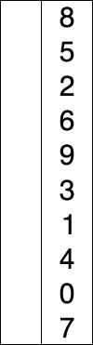
Sorting
Algo | Selection sort
In-place? | Yes
Stable? | No
Best runtime | O(n^2)
Average runtime | O(n^2)
Worst runtime | O(n^2)
Loop Invariant | At the end of iteration j: the smallest j items are correctly sorted in the first j positions of the array.
Remarks | Idea is to select minimum element in the unsorted sub array

Slide 7
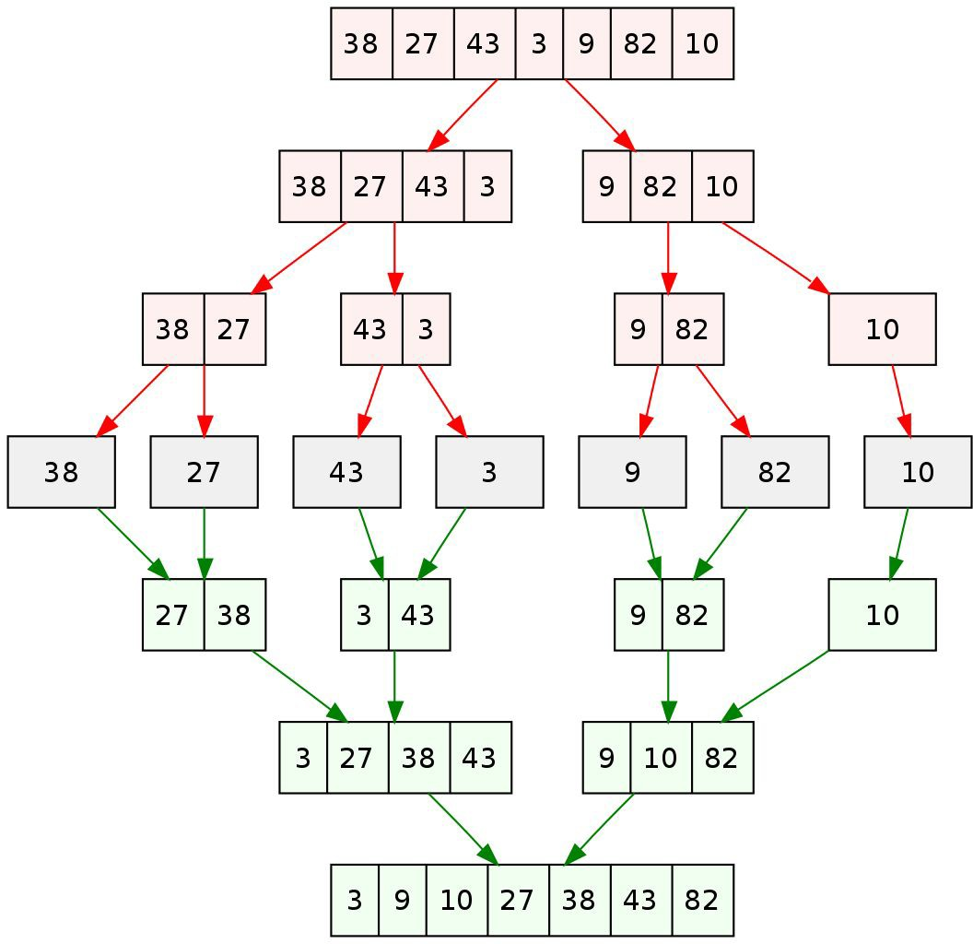
Sorting
Algo | Merge sort
In-place? | Usually no
Stable? | yes
Best runtime | O(nlogn)
Average runtime | O(nlogn)
Worst runtime | O(nlogn)
Loop Invariant
Remarks | Divide and conquer.

Slide 8
from 3230 slides

Slide 9
Sorting(Quicksort)
Algo | Quick sort
In-place? | Yes
Stable? | No
Best runtime | O(nlogn)
Average runtime | O(nlogn)
Worst runtime | O(n^2)
Loop Invariant | All elements on the left of the pivot are smaller than the pivot, vice versa for the right side
Remarks

Slide 10
Tutorial

Slide 11
Qn2(a)
How would you implement insertion sort recursively?
Analyse the time complexity by formulating a recurrence relation.

Slide 12
Qn2(a) (Answer)
Recursively sort the array from index 0 to (n - 1). Then, insert the last element
into the sorted subarray.
Recurrence relation: T(n) = T(n - 1) + O(n). Time complexity O(n²).

Slide 13
Qn2(b)
Consider an array of pairs (a,b). Your goal is to sort them by a in ascending order first, and then by b in ascending order.
Do you Merge sort first or Selection Sort

Slide 14
Qn2 (b) (Answer)
Consider the stability of each sort. Merge Sort: Stable
Selection Sort: Not stable
Selection Sort to sort pairs by their b, then Merge Sort to sort pairs by their a.
Selection Sort is unstable → if we used it to sort pairs by their a, we will not necessarily get ascending b for pairs with same a value.

Slide 15
Qn2(c)
We have learned how to implement MergeSort recursively. How would you implement Merge-Sort iteratively? Analyse the time and space complexity.

Slide 16
Qn2 (c) (Answer)
Increment sorting by power of 2
1st iteration = 2 2nd iteration = 4
...
Nth iteration = (2^n)

Slide 17
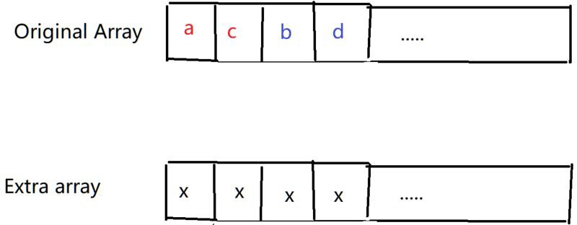
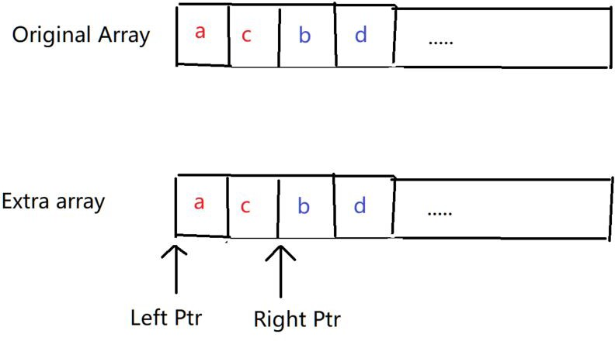
Qn2(c) (Answer)
Copy first half of the array into left array, second half into right array and set a left and right pointer to keep track

Slide 18
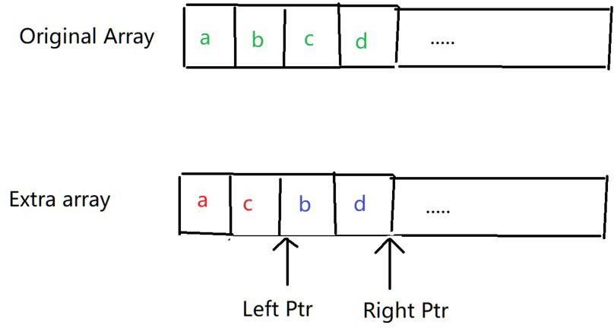
Qn2 (c) Answer
Compare elements with the pointer, writing the smaller element of the two into the original array
Repeat till the end of the array
After than repeat for size * 2 ...

Slide 19
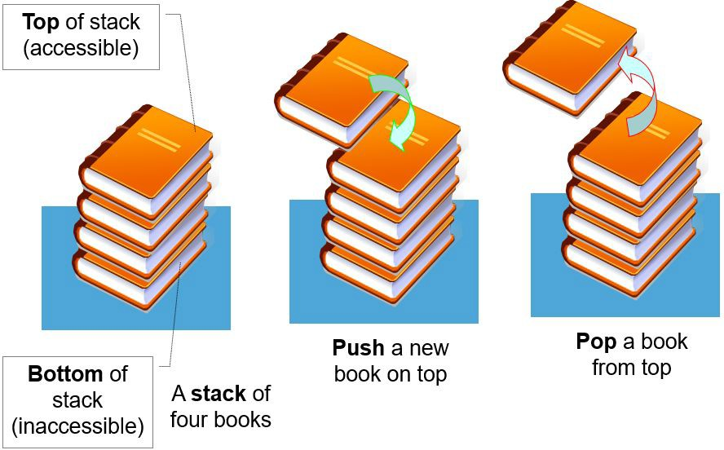
Stack
Last in first out
push(element) -> pushes an element to the top of the stack. pop() -> removes the top element of the stack.
peek() -> returns the last element added to the stack

Slide 20

Queues
First in first out
2 main functions
enqueue(element) -> Adds an element to the back of the queue. dequeue() -> Removes the element at the front of the queue. peek() -> Returns the next item to be dequeued

Slide 21
Qn3 a)
How would you implement a stack and queue with a fixed-size array in Java? (Assume that the number of items in the collections never exceed the array's capacity.)

Slide 22
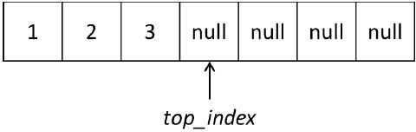
Qn3 a)
Maintain a variable top_index for the top of the stack (with initial value 0):
push → add element at top_index and increment top_index peek → return element at top_index - 1
pop → decrement top_index then return element at top_index

Slide 23
Qn3 a)
Queue: Maintain an head and tail index on the array.
On enqueue, set element to the arr[tailIdx] , tailIdx+ 1
On dequeue, return value at arr[headIdx] , set arr[headIdx] = null, index -1

Slide 24
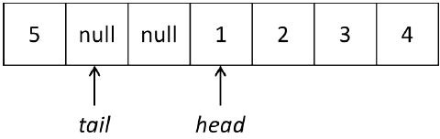
Qn3 a)
But if we increment head for each enqueue → we will eventually reach index out of bounds!
Solution: “wrap around” the array → incrementing at array.length gives 0 (i.e. instead of x++, we use (x+1) % array.length)

Slide 25
Qn3 (b)
A Deque (double-ended queue) is an extension of a queue, which allows
en-queueing and de-queueing from both ends of the queue. So the operations it would support are enqueue front, dequeue front, enqueue back, dequeue back. How can we implement a Deque with a fixed-size array in Java? (Again, assume that the number of items in the collections never exceed the array's capacity.)

Slide 26
Qn3 (b) Answer
Same as before,
_front ops will manipulate front index, but _back ops will manipulate tail index.

Slide 27
Qn3 c)
What sorts of error handling would we need, and how can we best handle these situations?

Slide 28
Qn3 c) Answer
For enqueue and push:
Edge case is when the capacity of the array is reached.
Can return false upon reaching capacity
For dequeue and pop:
Edge case is operating on empty collection (in this case, queue).
Can throw exception

Slide 29
Qn3 d)
A set of parentheses is said to be balanced as long as every opening parenthesis “(” is closed by a closing parenthesis “)”. So for example, the strings “()()” and “(())” are balanced but the strings “)(())(” and “((” are not. Using a stack, determine whether a string of parentheses are balanced.

Slide 30
Qn3 d) Answer
Traverse the string, push the opening brackets ‘(’ onto the stack, then pop one out whenever a closing parenthesis ‘)’ is seen.
String is unbalanced if:
There’s attempt at popping on empty stack, OR
The stack is non-empty after reading the last character.
Alternate way without using a stack: using an integer.
Bonus: what if there are multiple different type of parentheses such as {} and []?

Slide 31
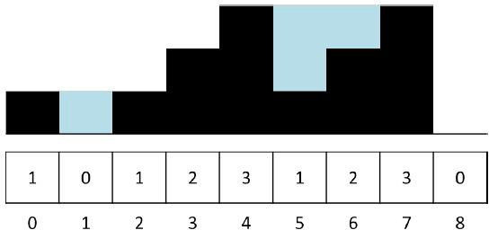
Given arrayof the height of the houses in the village, determine the number of houses that will be flooded.
Qn4

Slide 32
Qn4 Answer
Maintain a monotonic stack (either increasing or decreasing)
In this case, we are using a decreasing monotonic stack. For every element i,
If stack is non empty, pop all elements less than i Add the number of elements popped into the result Push i into the stack

Slide 33
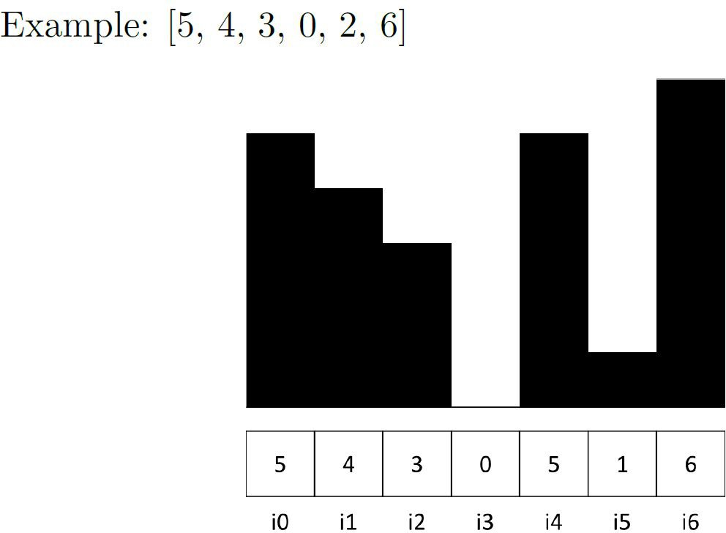
Qn4 Answer
res = 0, stack: {}
i0 -> push to stack i1 -> push to stack i2 -> push to stack i3 -> push to stack
Stack at the moment: {5,4,3,0}

Slide 34
Qn4 Answer
res = 0, stack: {5,4,3,0}
i4 -> 5 is larger then peek(0), pop, res++ res = 1, stack: {5,4,3}
5 > peek(3), pop, res ++ res = 2, stack: {5,4}
5 > peek(4), pop, res ++ res = 3, stack: {5}

Slide 35
Qn4 Answer
res = 3, stack: {5}
push (5), stack: {5, 5} i5 -> push to stack
i6 -> Same as before pop all 3 from stack. res = 6, stack : {}
Keep track of max, max_count(number of max values popped)
Max = 5, max_count = 2

Slide 36
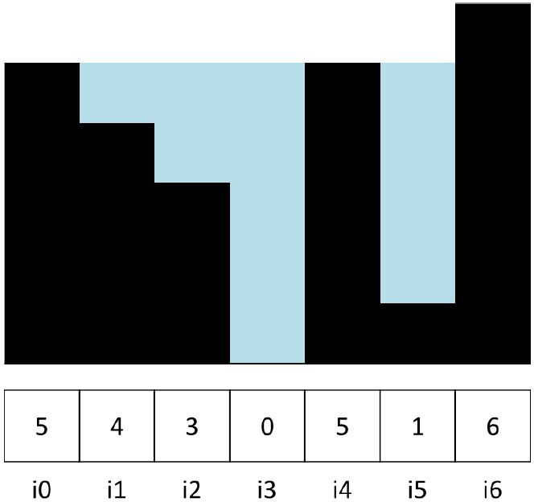
Qn4 Answer
Since stack is now the new max,
Previous max will not be flooded res -= max_count
push()
res = 4, stack = {6}

Slide 37
Sort a queue using another queue with O(1) additional space.
Qn5 (Optional)

Slide 38
Qn5
O(n^2) way: cycling through the queue, picking the minimum element each time, and appending it to the second queue.
O(nlogn) way: merge sort

Slide 39
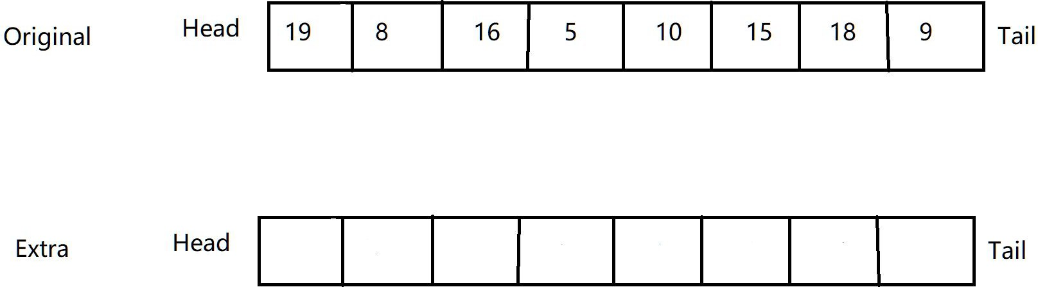
Qn5 Answer
Same idea as iterative merge sort, check from size 2, 4 .... n^2

Slide 40
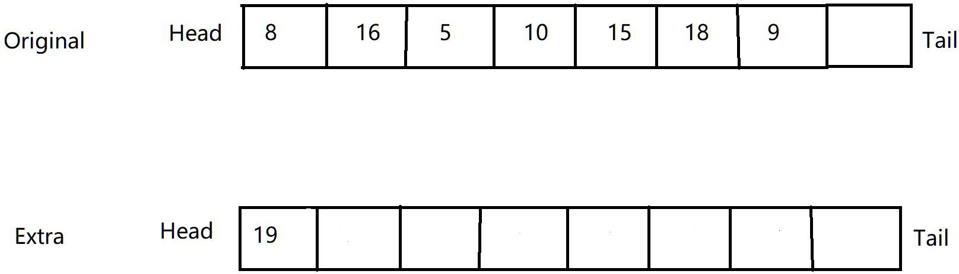
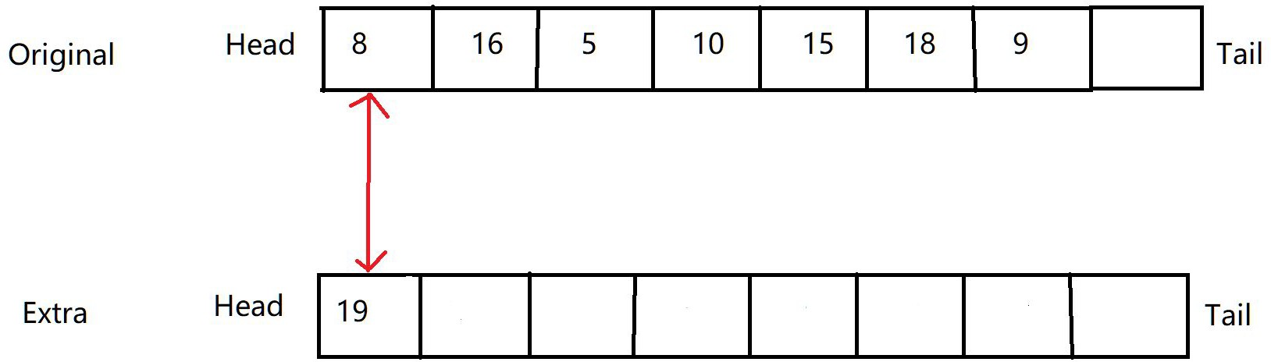
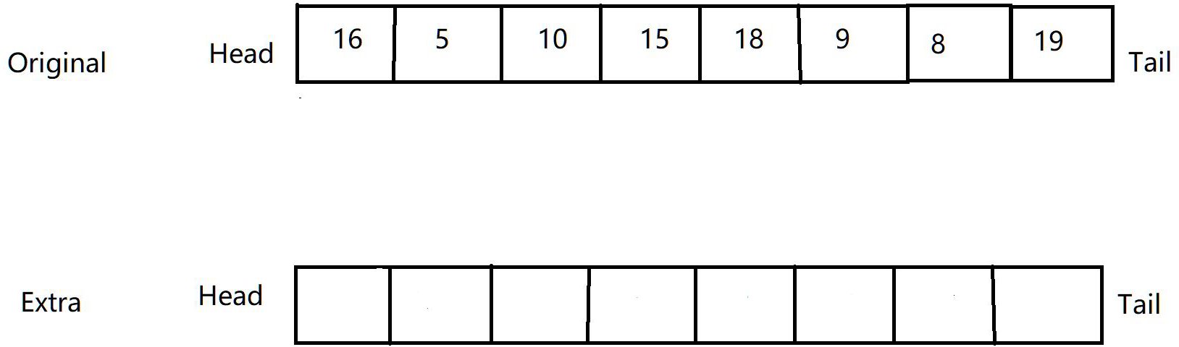
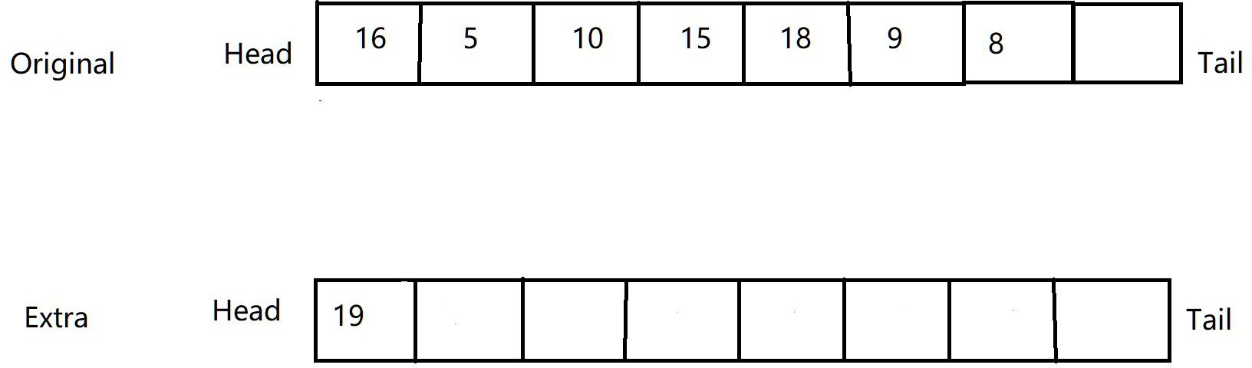
Qn5 Answer
Dequeue first half of the size, enqueue into extra queue
Compare heads, then enqueue smaller element into original array, followed by leather element

Slide 41
Qn5 Answer
Repeat the process for larger sizes unless the queue is sorted
End of size 2
End of size 4

